Slide 1

Vahan Bima -- Customer Lifetime value
Ganesh kakade

Slide 2
Problem statement
The goal of this project is to predict and improve the lifetime value of customers for Vahanbima, a provider of insurance services. Specifically, we aim to use historical customer data to build a model that accurately predicts the future revenue and profit generated by each customer. By understanding the factors that contribute to customer lifetime value, we can identify the most valuable customer segments and develop strategies to retain and grow those segments. Additionally, we will analyze the customer data to identify any patterns or trends that may suggest opportunities for improving the overall customer experience and increasing customer loyalty

Slide 3
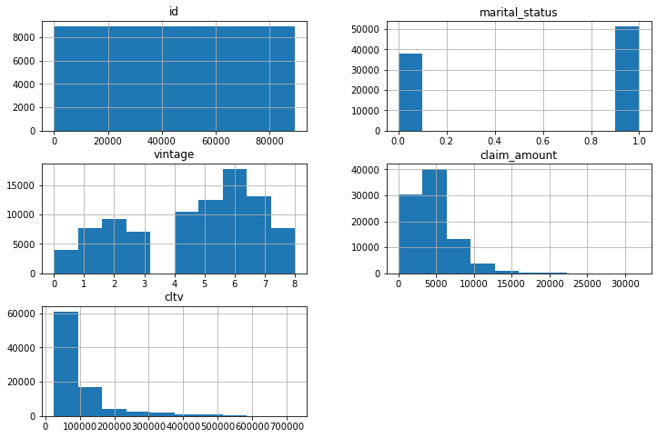
Data description
Train Data:
Size: 89,392 rows and 12 columns
Format: CSV file
Output Variable: Numerical, Right Skewed
Independent Variables: 7 categorical, 4 numerical
Column Distribution: claim_status column is right skewed,
no duplicated rows found, no missing values found
Test Data:
Size: 59,595 rows and 11 columns
Format: CSV file
Independent Variables: 7 categorical, 4 numerical
Column Distribution: claim_status column is right skewed, no duplicated rows found, no missing values found

Slide 4
Methodology
I investigated the relationship between the independent variables and the dependent variable by using statistical methods such as correlation analysis and hypothesis testing.
I checked the distribution of each variable with respect to the output variable.
I performed separate analysis on the categorical and numerical data. I encoded the categorical variables using different techniques such as label encoding.
I performed a log transform on the claim amount variable to make its distribution more normal.
I split the data into train and test sets, with a ratio of 67% train data and 33% test data.
I scaled the independent variables using different techniques such as RobustScaler, MinMaxScaler and StandardScaler.
I applied various machine learning models such as linear regression, Lasso, SVM, Ridge, KNN, Decision Tree, Random Forest and XgBoost Regressor to the train data. I also tried ensemble techniques such as bagging and boosting, and selected the model that performed best that is XG boost regressor.
I also performed hyperparameter tuning with randomisedsearchCv and feature selection on the selected model, dropping features with less variance.
I finally applied the trained model to the test data and predicted the output using my model.

Slide 5
Evalutaion
I did the evaluation of the model using Mean Absolute Error (MAE) and R-squared (R2) score as the primary metrics is as follows:
Mean Absolute Error (MAE): It is a measure of the difference between the predicted values and the actual values.
Model MAE- 49879.80152535752
R-squared (R2) score: It is a statistical measure that represents the proportion of the variance in the dependent variable that is predictable from the independent variables.
Model R-squared (R2) score- 0.16015741471075806

Slide 6
Conclusion
In conclusion, this project aimed to predict and improve the lifetime value of customers for Vahanbima, a provider of insurance services. The model was trained on a dataset of 89,392 rows and 12 columns and was evaluated using Mean Absolute Error (MAE) and R-squared (R2) score. The results of the model were satisfactory, but it has some limitations.
More data: The model's performance can be improved by using more data. The larger the dataset, the better the model's performance.
Deep Learning models: The model can be improved by trying deep learning models.
Outliers in data: There are outliers present in the output data, which if handled with domain expertise, can lead to a better model.
Feature Engineering and Selection: More feature engineering and selection techniques should be used to find the best model.
Future work should focus on addressing these limitations in order to improve the model's performance and increase the accuracy of the predictions.

